Slide 1
BRITISH AIRWAYS VIRTUAL INTERNSHIP
SUBMITTED BY,
VISHAK KRISHNAN

Slide 2
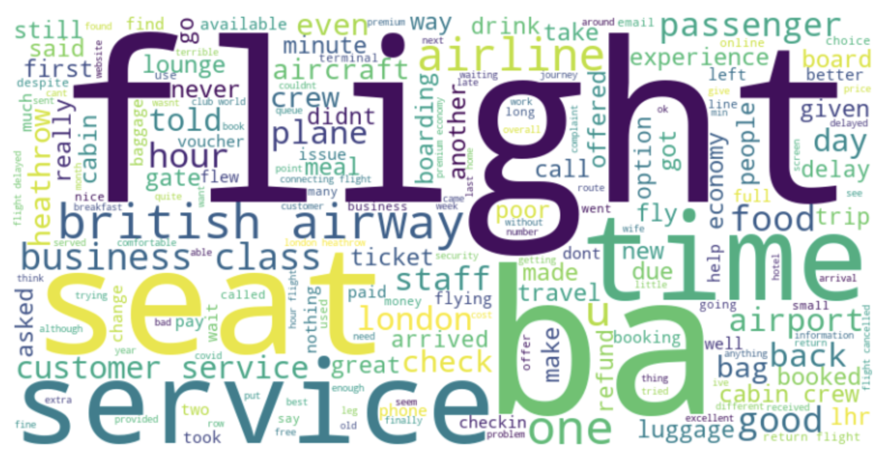
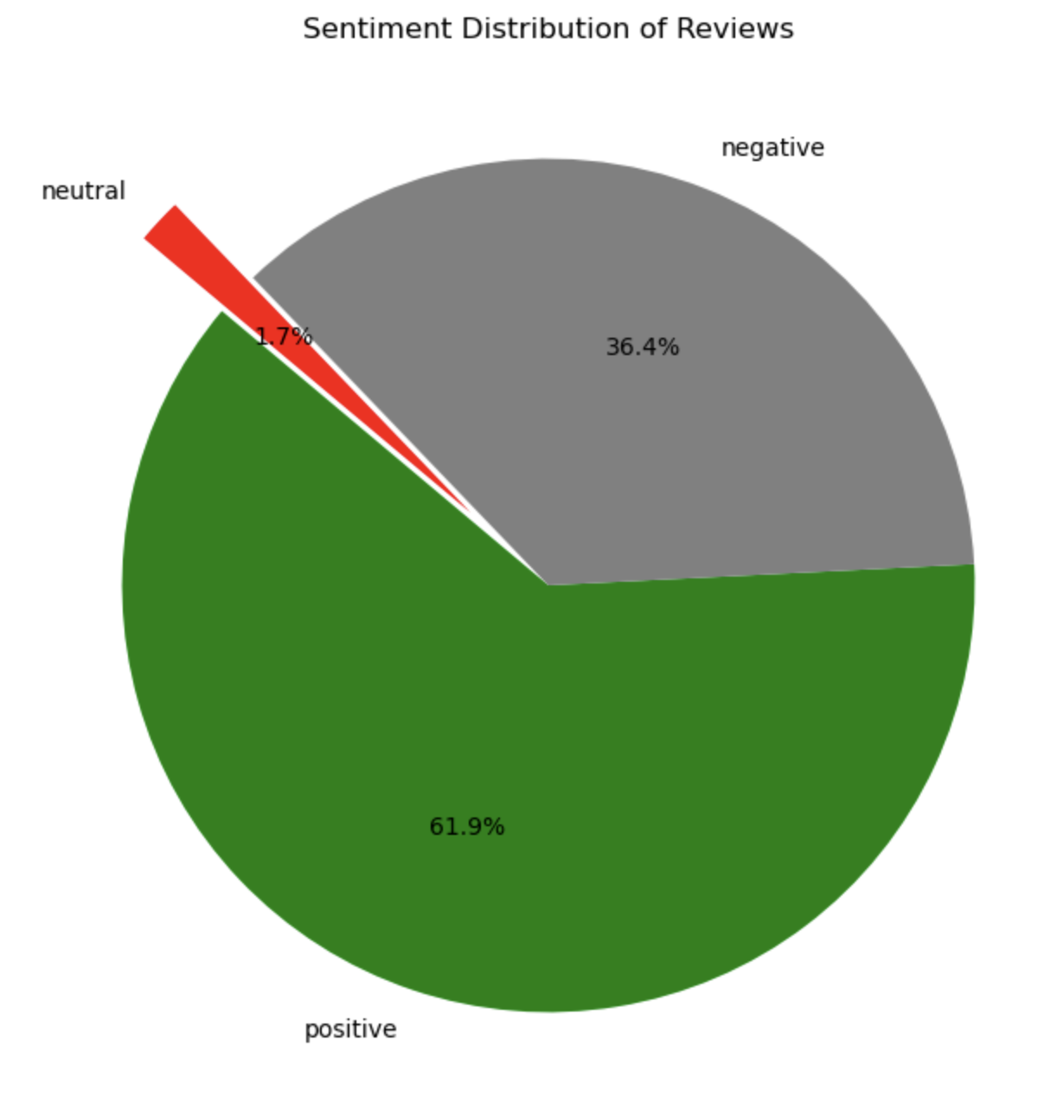
SUMMARY
Most customer reviews (61.9%) are positive, indicating a generally favorable perception of British Airways' services, despite a significant portion (36.4%) being negative.
The most frequently mentioned words in reviews include "flight," "seat," "service," and "time," highlighting customer focusing on punctuality, seating comfort, and overall service experience.

